Slide 1
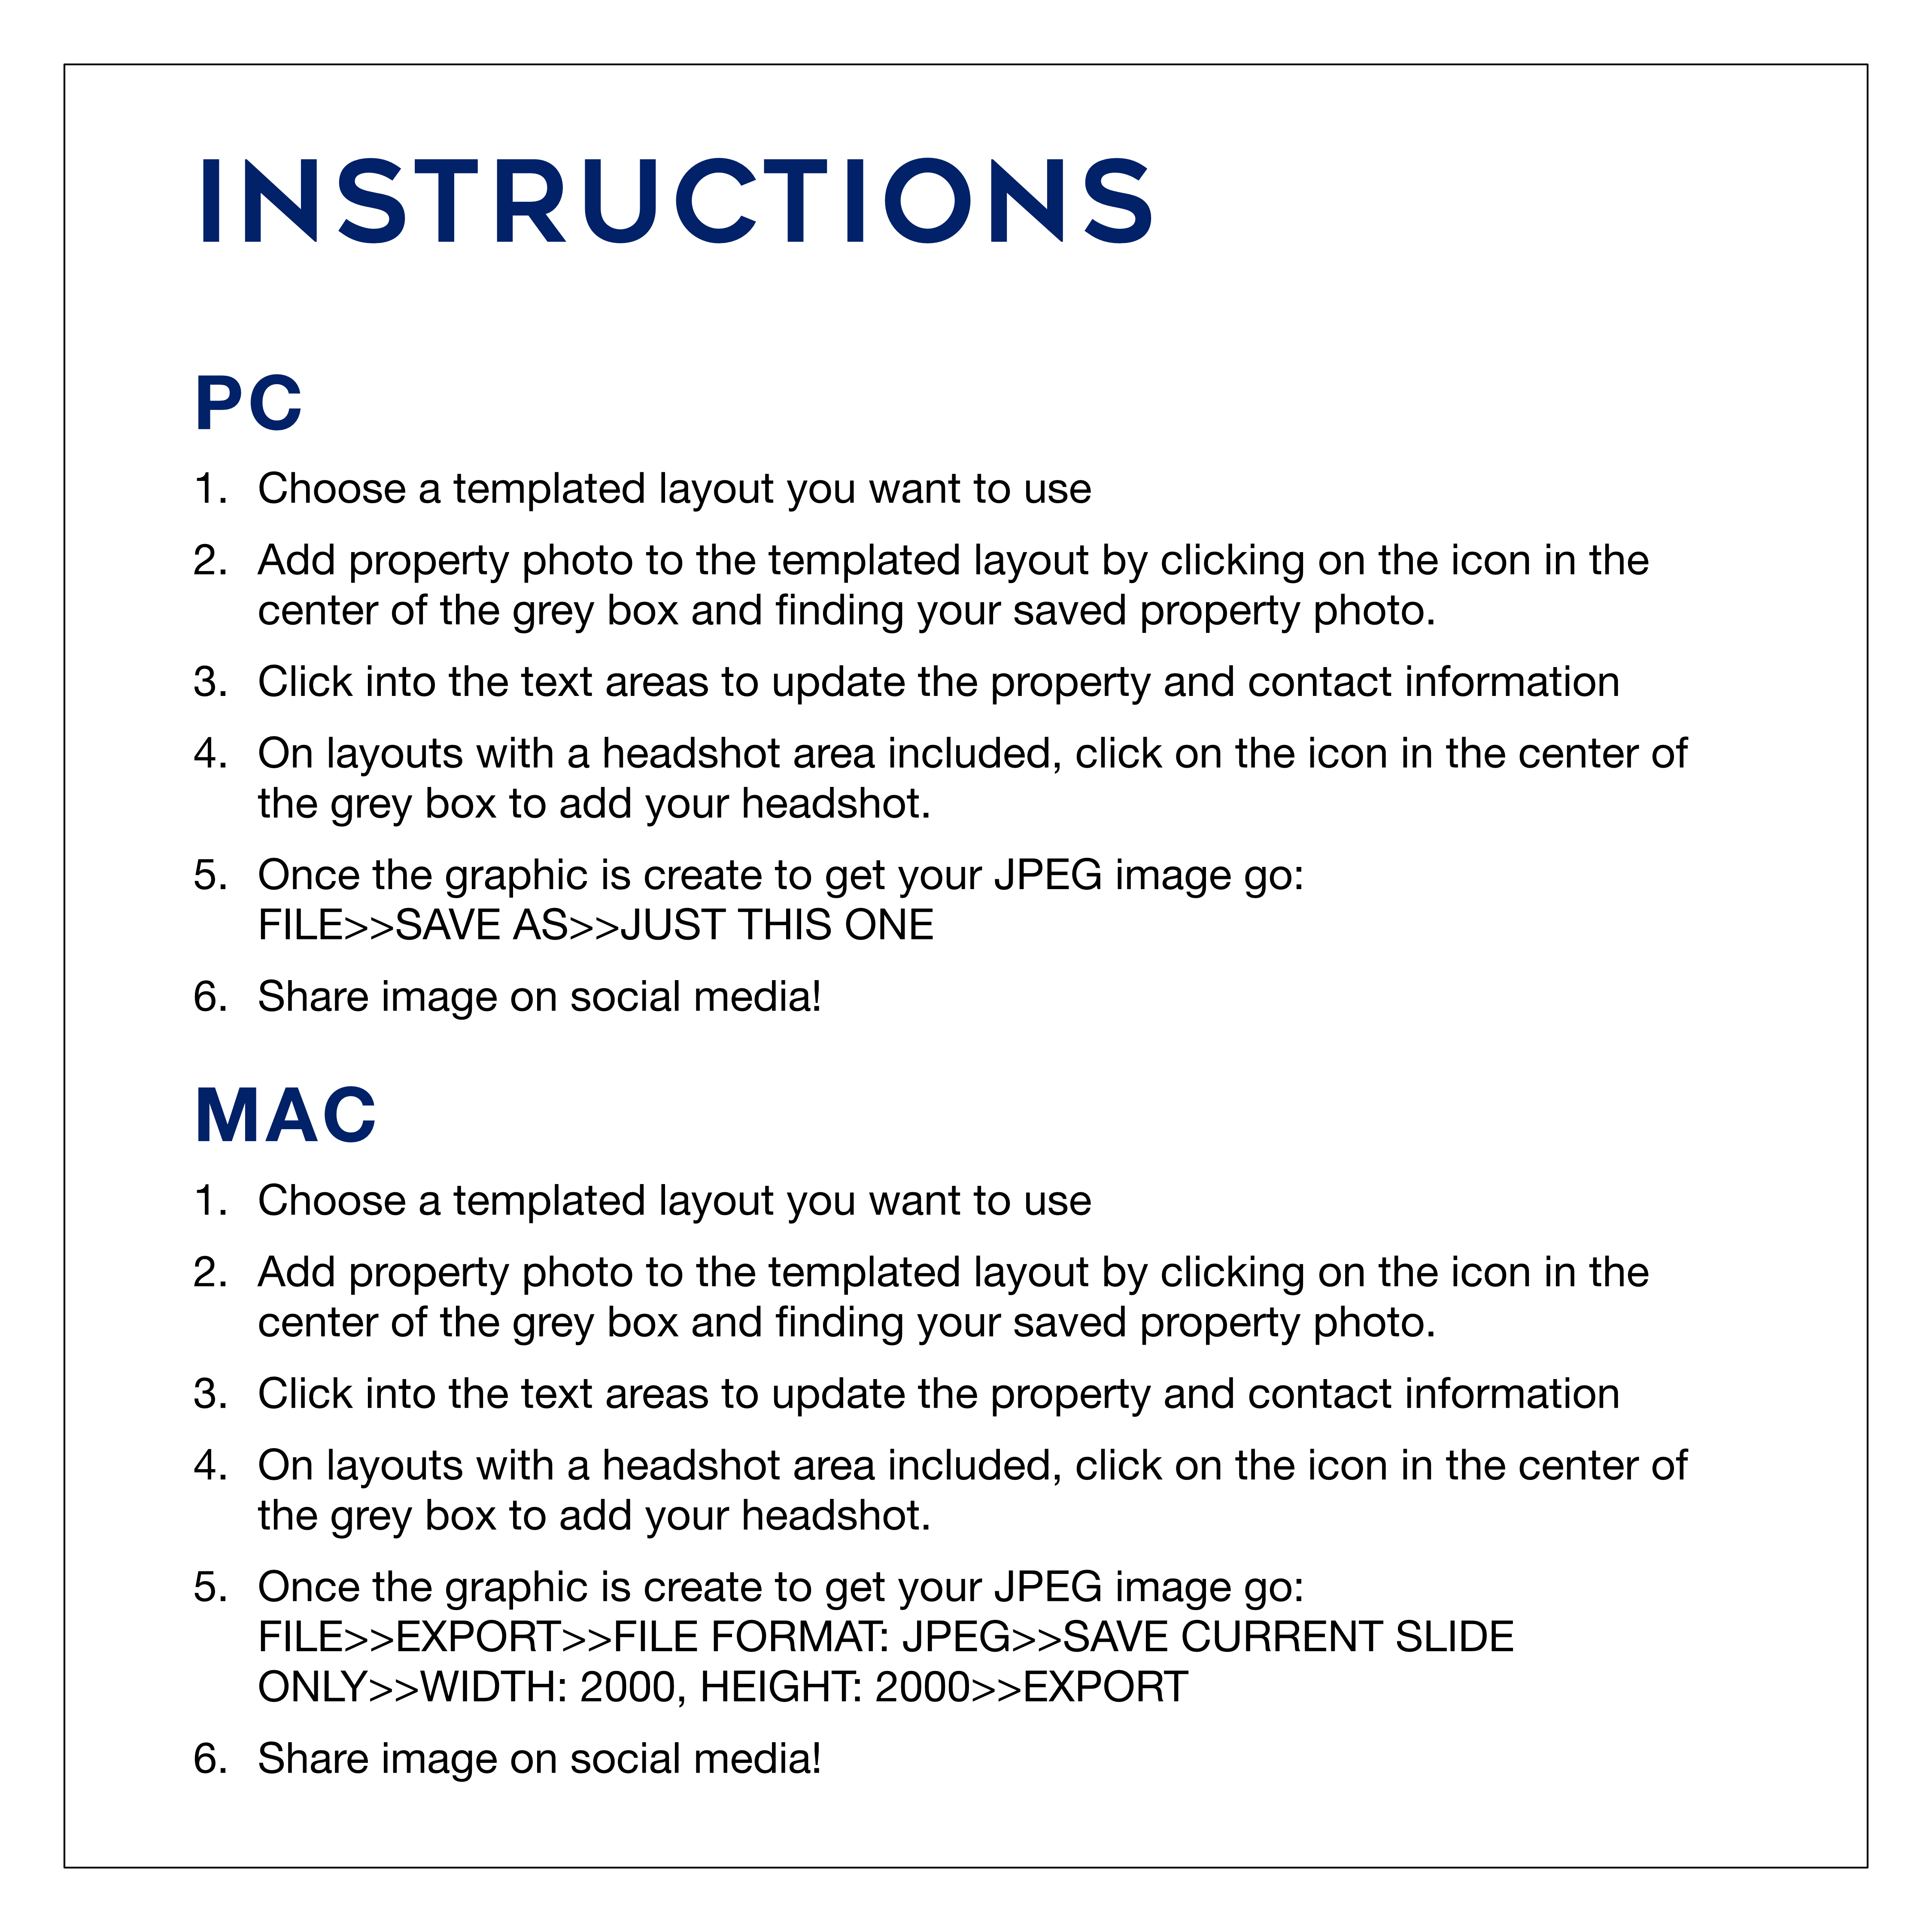

Slide 2

JUST LISTED!
1234 N ADDRESS ST
0 BD • 0 BA • 0,000 Sq Ft • $000,000
Agent Name
000.000.0000
agentname@gmail.com
aname.website.com

Slide 3
JUST LISTED!
1234 N ADDRESS ST
0 BD • 0 BA • 0,000 Sq Ft • $000,000
Agent Name
000.000.0000
agentname@gmail.com
aname.website.com

Slide 4

JUST LISTED!
1234 N ADDRESS ST
0 BD • 0 BA • 0,000 Sq Ft • $000,000
Agent Name
000.000.0000
agentname@gmail.com
aname.website.com
Agent Name
000.000.0000
agentname@gmail.com
aname.website.com

Slide 5
JUST LISTED!
1234 N ADDRESS ST
0 BD • 0 BA • 0,000 Sq Ft • $000,000
Agent Name
000.000.0000
agentname@gmail.com
aname.website.com
Agent Name
000.000.0000
agentname@gmail.com
aname.website.com

Slide 6
JUST LISTED!
1234 N ADDRESS ST
0 BD • 0 BA • 0,000 Sq Ft • $000,000
Team Name
000.000.0000
teamname@gmail.com
tname.website.com

Slide 7
JUST Sold!
FOR $000,000
1234 N Address St, City, AA 99999
Agent Name
000.000.0000
agentname@gmail.com
aname.website.com

Slide 8
JUST SOLD!
FOR $000,000
1234 N Address St, City, AA 99999
Agent Name
000.000.0000
agentname@gmail.com
aname.website.com

Slide 9

JUST Sold!
FOR $000,000
1234 N Address St, City, AA 99999
Agent Name
000.000.0000
agentname@gmail.com
aname.website.com
Agent Name
000.000.0000
agentname@gmail.com
aname.website.com

Slide 10
JUST Sold!
FOR $000,000
1234 N Address St, City, AA 99999
Agent Name
000.000.0000
agentname@gmail.com
aname.website.com
Agent Name
000.000.0000
agentname@gmail.com
aname.website.com

Slide 11
JUST Sold!
FOR $000,000
1234 N Address St, City, AA 99999
Team Name
000.000.0000
teamname@gmail.com
tname.website.com

Slide 12
NEW PRICE!
1234 N ADDRESS ST
0 BD • 0 BA • 0,000 Sq Ft • Now $000,000
Agent Name
000.000.0000
agentname@gmail.com
aname.website.com

Slide 13
NEW PRICE!
1234 N ADDRESS ST
0 BD • 0 BA • 0,000 Sq Ft • Now $000,000
Agent Name
000.000.0000
agentname@gmail.com
aname.website.com

Slide 14
NEW PRICE!
1234 N ADDRESS ST
0 BD • 0 BA • 0,000 Sq Ft • Now $000,000
Agent Name
000.000.0000
agentname@gmail.com
aname.website.com
Agent Name
000.000.0000
agentname@gmail.com
aname.website.com

Slide 15
NEW PRICE!
1234 N ADDRESS ST
0 BD • 0 BA • 0,000 Sq Ft • Now $000,000
Agent Name
000.000.0000
agentname@gmail.com
aname.website.com
Agent Name
000.000.0000
agentname@gmail.com
aname.website.com

Slide 16
NEW PRICE!
1234 N ADDRESS ST
0 BD • 0 BA • 0,000 Sq Ft • Now $000,000
Team Name
000.000.0000
teamname@gmail.com
tname.website.com

Slide 17

OPEN HOUSE
Saturday | 12-3pm
1234 N ADDRESS ST
0 BD • 0 BA • 0,000 Sq Ft • $000,000
Agent Name
000.000.0000
agentname@gmail.com
aname.website.com

Slide 18
OPEN HOUSE
Saturday | 12-3pm
1234 N ADDRESS ST
0 BD • 0 BA • 0,000 Sq Ft • $000,000
Agent Name
000.000.0000
agentname@gmail.com
aname.website.com

Slide 19

OPEN HOUSE
Saturday | 12-3pm
1234 N ADDRESS ST
0 BD • 0 BA • 0,000 Sq Ft • $000,000
Agent Name
000.000.0000
agentname@gmail.com
aname.website.com
Agent Name
000.000.0000
agentname@gmail.com
aname.website.com

Slide 20

OPEN HOUSE
Saturday | 12-3pm
1234 N ADDRESS ST
0 BD • 0 BA • 0,000 Sq Ft • $000,000
Agent Name
000.000.0000
agentname@gmail.com
aname.website.com
Agent Name
000.000.0000
agentname@gmail.com
aname.website.com

Slide 21
OPEN HOUSE
Saturday | 12-3pm
1234 N ADDRESS ST
0 BD • 0 BA • 0,000 Sq Ft • $000,000
Team Name
000.000.0000
teamname@gmail.com
tname.website.com

Slide 22
INSERT PROPERTY HEADLINE HERE INSERT PROPERTY HEADLINE HERE
Agent Name
000.000.0000
agentname@gmail.com
aname.website.com

Slide 23
INSERT PROPERTY HEADLINE HERE INSERT PROPERTY HEADLINE HERE
Agent Name
000.000.0000
agentname@gmail.com
aname.website.com

Slide 24
INSERT PROPERTY HEADLINE HERE INSERT PROPERTY HEADLINE HERE
Agent Name
000.000.0000
agentname@gmail.com
aname.website.com
Agent Name
000.000.0000
agentname@gmail.com
aname.website.com

Slide 25
INSERT PROPERTY HEADLINE HERE INSERT PROPERTY HEADLINE HERE
Agent Name
000.000.0000
agentname@gmail.com
aname.website.com
Agent Name
000.000.0000
agentname@gmail.com
aname.website.com

Slide 26
INSERT PROPERTY HEADLINE HERE INSERT PROPERTY HEADLINE HERE
Team Name
000.000.0000
teamname@gmail.com
tname.website.com

