Slide 1
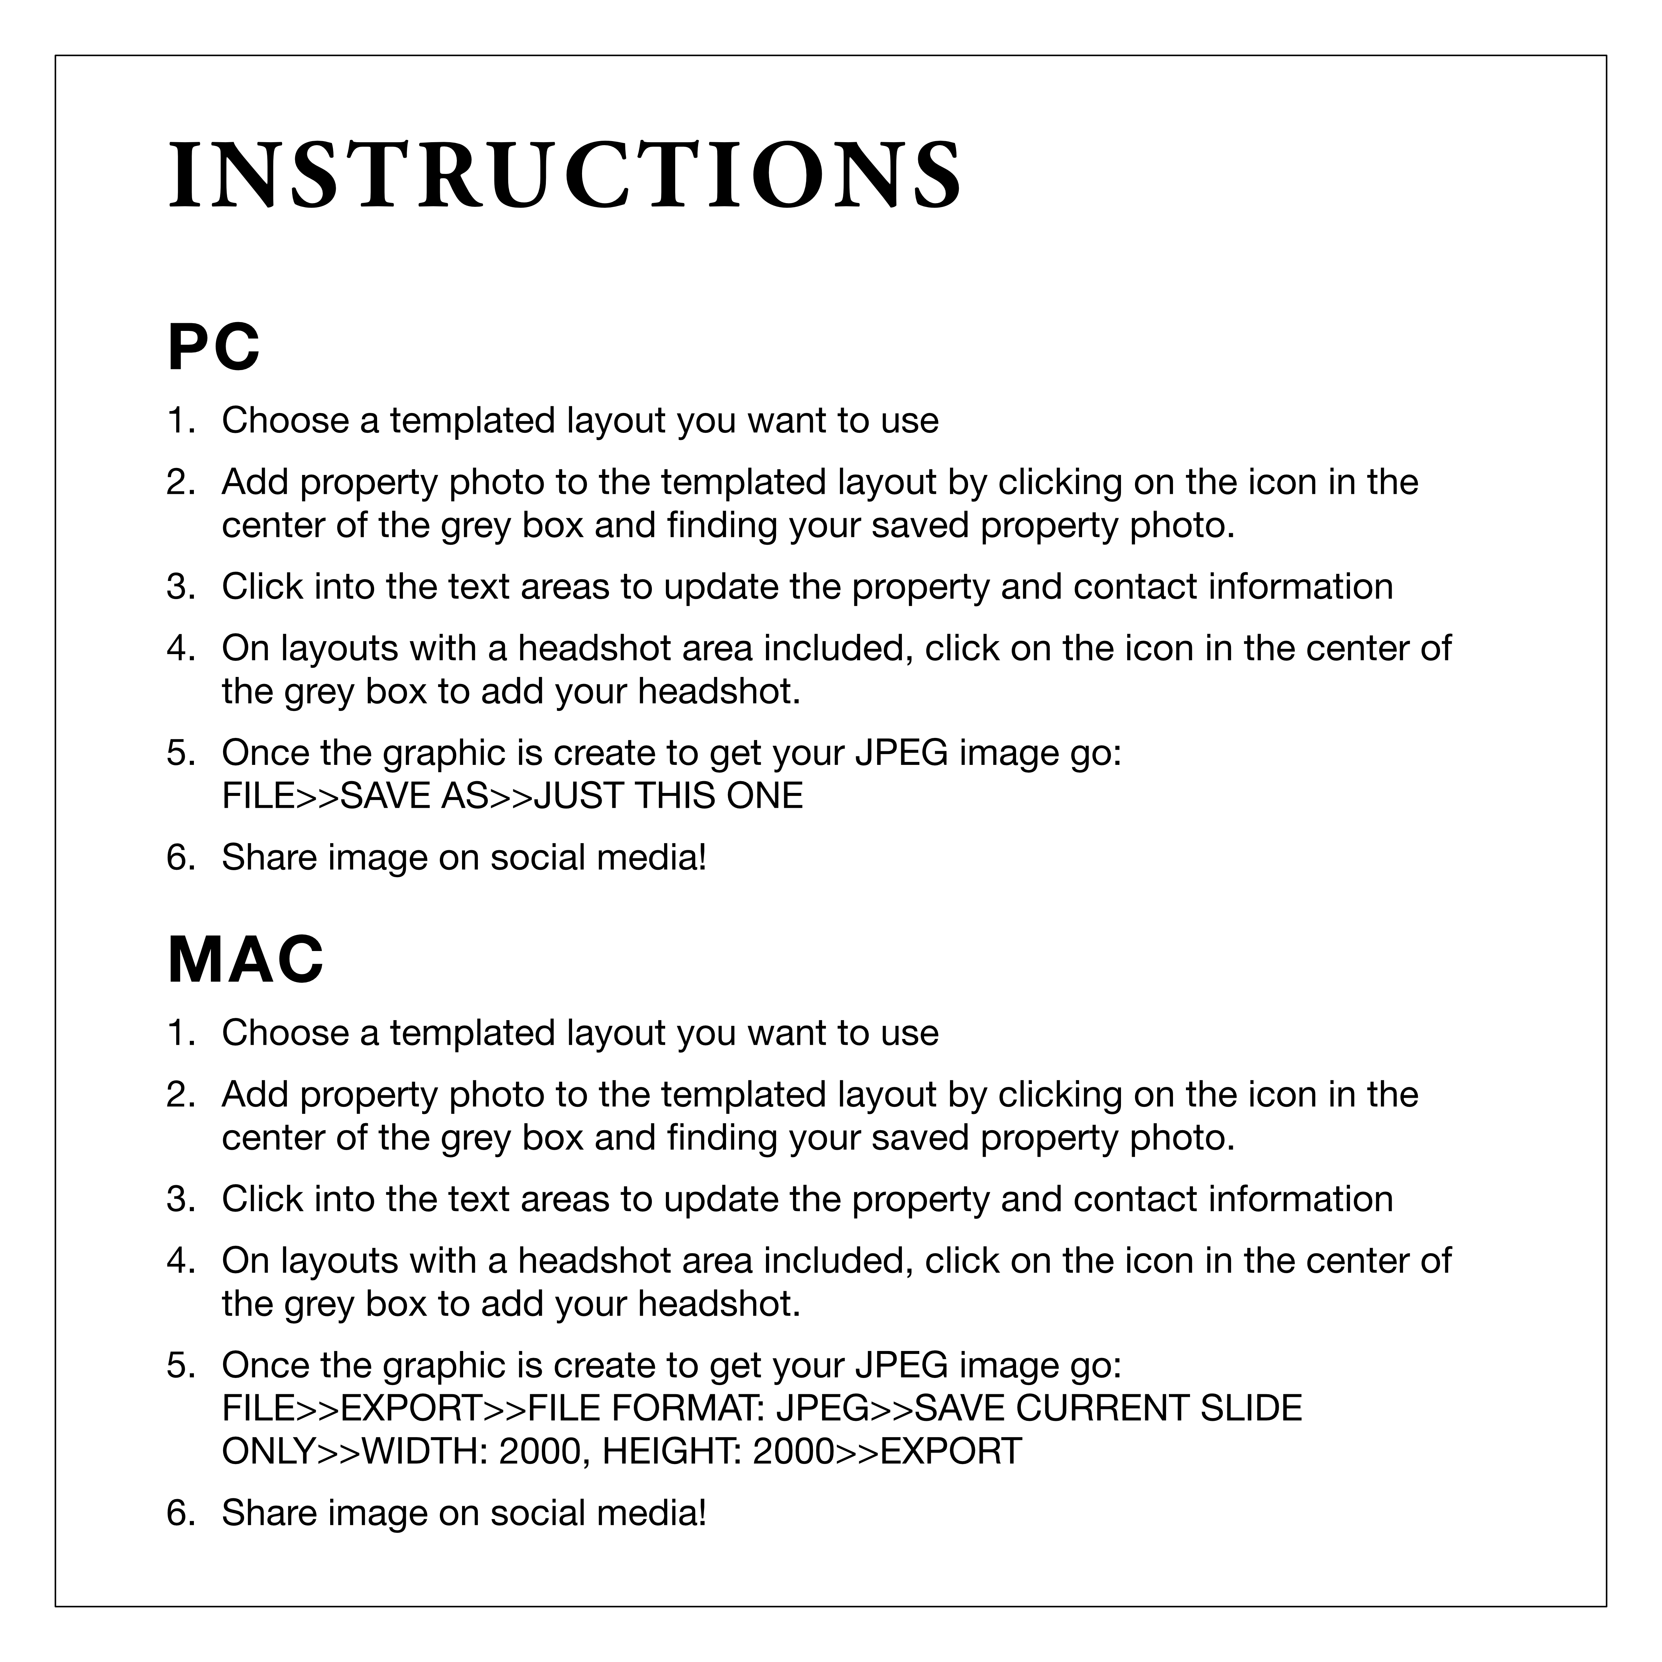

Slide 2

JUST LISTED!
1234 N ADDRESS ST
0 BD • 0 BA • 0,000 Sq Ft • $000,000
Agent Name
000.000.0000
agentname@gmail.com
aname.website.com

Slide 3
JUST LISTED!
1234 N ADDRESS ST
0 BD • 0 BA • 0,000 Sq Ft • $000,000
Agent Name
000.000.0000
agentname@gmail.com
aname.website.com

Slide 4
JUST SOLD!
FOR $000,000
1234 N Address St, City, AA 99999
Agent Name
000.000.0000
agentname@gmail.com
aname.website.com

Slide 5
JUST SOLD!
FOR $000,000
1234 N Address St, City, AA 99999
Agent Name
000.000.0000
agentname@gmail.com
aname.website.com

Slide 6
NEW PRICE!
1234 N ADDRESS ST
0 BD • 0 BA • 0,000 Sq Ft • Now $000,000
Agent Name
000.000.0000
agentname@gmail.com
aname.website.com

Slide 7
NEW PRICE!
1234 N ADDRESS ST
0 BD • 0 BA • 0,000 Sq Ft • Now $000,000
Agent Name
000.000.0000
agentname@gmail.com
aname.website.com

Slide 8

OPEN HOUSE
Saturday | 12-3pm
1234 N ADDRESS ST
0 BD • 0 BA • 0,000 Sq Ft • $000,000
Agent Name
000.000.0000
agentname@gmail.com
aname.website.com

Slide 9
OPEN HOUSE
Saturday | 12-3pm
1234 N ADDRESS ST
0 BD • 0 BA • 0,000 Sq Ft • $000,000
Agent Name
000.000.0000
agentname@gmail.com
aname.website.com

Slide 10
INSERT PROPERTY HEADLINE HERE INSERT PROPERTY HEADLINE HERE
Agent Name
000.000.0000
agentname@gmail.com
aname.website.com

Slide 11
INSERT PROPERTY HEADLINE HERE INSERT PROPERTY HEADLINE HERE
Agent Name
000.000.0000
agentname@gmail.com
aname.website.com

