Slide 1

PRESENTED BY AGENT NAME
REALTOR®/BROKER
123-456-7890
aname@cbtabs.com
Jim & Jane Smith
1234 N Address St
Kennewick, WA 99336

Slide 2
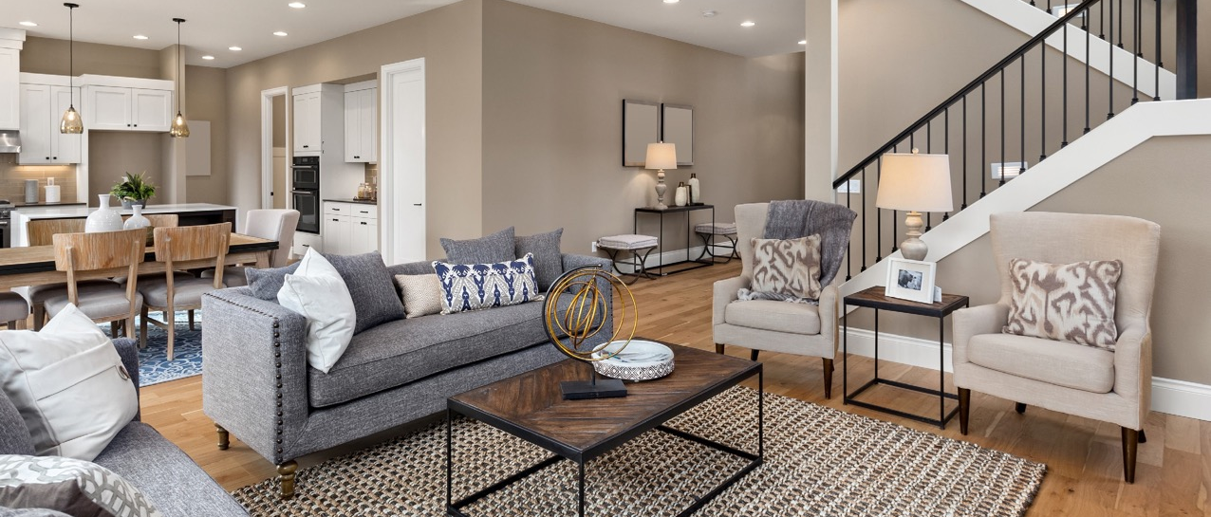
PLAN & PROMISE
I offer one of the most powerful and comprehensive marketing programs for attracting buyers and getting homes sold. In combination with marketing your home, I will provide:
CMA / Settlement Statement
Absorption Pricing
Written Communication Plan
Seller Services Guarantee
PREPARING YOUR HOME FOR THE MARKET
Before your home hits the market, we need to get it looking it’s best. I have a team of trusted professionals that I will hire to make sure your home stands and is ready to hit the local real estate market.
Professional Home Staging
Professional Property Photography
Matterport 3D Virtual Home Tour
Drone Photography
Video Tour Production
Yard Sign Installation
Lockbox Installation

Slide 3

WHERE THE BUYERS ARE
While buyers use a variety of resources to research properties for sale in their area, the vast majority find their new home online and with the help of a real estate professional.*
HOW BUYERS SEARCH FOR HOMES:
WHERE BUYERS FOUND THE HOME THEY PURCHASED:
Online
Real Estate Agent
Mobile Sites and Apps
Open House
Yard Sign
Online Video
Home Builder
Print Newspaper Ad
93%
87%
73%
51%
39%
35%
15%
11%
Internet
Real Estate Agent
Yard Sign
Friend, Neighbor or Relative
Home Builder or Their Agent
Directly from Sellers
52%
29%
6%
6%
4%
3%
*2019 National Association of REALTORS® Profile of Home Buyers and Sellers

Slide 4
ON THE WEB
Your home will be shown on high-traffic websites, including some of the most-visited real estate websites in the world, putting it in front of potential buyers everywhere. Our comprehensive internet marketing strategy includes displaying your home with a detailed description and multiple photos on the most-visited real estate websites.
cbt-tc.com
50+ partner channels to which your listing is automatically marketed and syndicated out to for maximum digital coverage.
ONLINE TOOLS
Sending your home out to the internet isn’t the only thing we do. We promote your home in multiple platforms across the web, capturing the attention of buyers and receiving thousands of measurable impressions:
Coldwell Banker Dynamic Ads for Real Estate
Email Campaigns to past client & sphere
Google Advertisements
Social Media Targeted Advertisements using Social Ad Engine

Slide 5





SOURCING BUYERS
For your home’s marketing to be effective, it needs to reach the right audience. That’s where CBx comes in. Developed exclusively for Coldwell Banker® real estate professionals, CBx uses the power of technology to access in-depth housing data and home value trends, as well as detailed demographic data, enabling your Coldwell Banker Tomlinson REALTOR® to accurately price your home and target the most-likely buyers.
CBx DATA INCLUDES:
Median age
Average education level
Homes with children
Average family size
Median commute time
Average household income
Median mortgage debt
Increase in residents’ income
TARGETED SOCIAL
Using the CBx exclusive data and our market expertise, I can put your home in front of buyers who are most likely to buy. Social is a powerful tool that I leverage across my business.
Just Listed posts & stories
Open House posts & stories
Paid Property Ads using demographics, behaviors, geotargeted radius ad more on Instagram, Facebook, and Facebook Audience Network
Facebook Live Streams “Walk-through Wednesdays”
Matterport Paid Promotions “Walk-through Wednesdays”
Facebook.com/localpage
Twitter.com/localpage
YouTube.com/localpage
Instagram.com/localpage
TikTok.com/@localpage

Slide 6

PRINT ADVERTISING
While online marketing remains the most effective way of reaching home buyers today, it’s still beneficial to incorporate print marketing as well. We provide professionally designed print materials that enable us to showcase your property in the hands of potential buyers.
Professional Full-Color Flyers
Property Booklets
Counter Display
Property Information Cards
Special Feature Cards & Call-outs
Just Listed Neighborhood Door Hangers
Just Listed Geotargeted Postcards
Direct Mail Newsletters
Homes & Land Magazine Ads
Real Estate Book Magazine Ads
BRINGING EVEN MORE BUYERS
As an agent at Coldwell Banker, we have some of the best digital, social and online strategies. I know, however, that traditional marketing, broker-to-broker networking, and relocation services can be an invaluable tool when it comes to selling your home. I also provide:
Open Houses
Coldwell Banker Agent Tour
Promotion to Sphere of Influence
Broker’s Opens
Relocation Services
USAA Real Estate Reward Networks

Slide 7


24 WEEK
LISTING MARKETING PLAN
SUBJECT PROPERTY:
WEEKS ONE THROUGH THREE
*Install Yard sign and name rider
*Install lock box with keys to property
*Just Listed Postcards and Flyer Creation (office support provided)
*PACMLS information to appropriate key offices/agents in market area
*Schedule initial Brokers Open
*Provide PACMLS info on any new comps to seller (listed or sold)
*Introduce and share weekly Demand/Market Activity Report (This report is new actives, homes that have went pending and sold)
*Create property photography
*Create property information flyers or brochures
*Open and obtain preliminary title
*Schedule Communication and accountability appointment with Seller
*Stage listing if needed
*Create feature cards (if appropriate)
*Schedule Initial Public Open House, Use the Perfect Open House Approach
*Informational flyer/brochure to key agents in market area
*Initial newspaper/periodical ads written and placed if indicated
*Contact a lender for informational loan flyers
*Check uploads to all appropriate Internet sites
*indicates a first-time activity
Weekly Communication to the Sellers
Feedback from all showings
Updates on the marketing you are doing each week
Current Active properties
Properties that were active when you listed but are now under contract
Properties that sold since you did your CMA
How many showings have we had so far?
The main purpose of committing to a weekly plan is to keep the seller informed of the activity in the market and to show the value you provide as an agent. By using this approach, a potential price reduction conversation becomes very natural and is well received by your client.

Slide 8
WEEKS TWO THROUGH FOUR
*Install Yard sign and name rider
*Schedule Perfect Open House
Email MLS sheet on any comps (listed or sold)
*ListTrac Online Report
Analyze demand and competitive market activity
Communication/progress appointment with Seller
*Create E-mail flyer and distribute to list
*Fax/email campaign to agents with listings in the area
ListTrac Report to Seller
HOW MANY SHOWINGS HAVE WE HAD SO FAR:
WEEKS FOUR THROUGH SIX
ListTrac Online Report
Mail MLS sheet on any comps (listed or sold)
Analyze demand and competitive market activity
Communication/progress appointment with Seller
Obtain price adjustment, if agreed
Change remarks in MLS (refocus attention on an alternative property feature)
Alter marketing remarks on Internet (emotional rotation)
Mail any new advertising to seller
Obtain feedback remarks from other agents & review with Seller
Review staging based on showings.
HOW MANY SHOWINGS HAVE WE HAD SO FAR:
WEEKS SEVEN THROUGH EIGHT
HOW MANY SHOWINGS HAVE WE HAD SO FAR:
Mail MLS sheet on any comps (listed or sold)
Analyze demand/market activity — ListTrac Report to Seller
Communication/Progress appointment with Seller
Email campaign to preferred co-op agent list
Schedule an “Event Open House” as appropriate
Review pricing strategy**
A PRICE REDUCTION GENERATES THE FOLLOWING:
Updated flyer
New Internet information
New contact with Realtors who have already shown the Property
HOW MANY SHOWINGS HAVE WE HAD SO FAR:

Slide 9
WEEKS NINE THROUGH TEN
Mail MLS sheet on any comps (listed or sold)
Change remarks in MLS
Communication/Progress appointment with Seller — ListTrac Report to Seller
Analyze demand and market activity
Re-promote at CB Sales Meeting
Submit Open House ad (if applicable)
Offer to give seller tour of comparable active listings
HOW MANY SHOWINGS HAVE WE HAD SO FAR:
WEEKS ELEVEN THROUGH TWELVE
Continue Open House(s)
Mail MLS sheet on any comps (listed or sold)
Communication/Progress appointment with Seller
Progress Interview with Seller
Alternative information flyer (refocus on alternative emotional amenities)
HOW MANY SHOWINGS HAVE WE HAD SO FAR:
WEEKS THIRTEEN THROUGH FOURTEEN
Mail MLS sheet on any comps (listed or sold)
Communication/Progress appointment with Seller
Analyze demand and market activity
*Call Seller to explain your interpretation RE news reports
*Consider ads in smaller, out of the way publications, if relevant
HOW MANY SHOWINGS HAVE WE HAD SO FAR:
WEEKS FIFTEEN THROUGH SIXTEEN
Mail MLS sheet on any comps (listed or sold)
Change remarks in MLS
Communication/Progress appointment with Seller
Analyze demand and market activity
Send flyers
Schedule a Broker's Open “Event Tour”
Review pricing strategy
HOW MANY SHOWINGS HAVE WE HAD SO FAR:

Slide 10
WEEKS SEVENTEEN THROUGH EIGHTEEN
Have an Open House
Mail MLS sheet on any comps (listed or sold)
Change remarks in MLS
Communication/Progress appointment with Seller Run Absorption Report
Progress Interview with Seller
Promote at CBTABS Sales Meeting
HOW MANY SHOWINGS HAVE WE HAD SO FAR:
WEEKS NINETEEN THROUGH TWENTY
Mail MLS sheet on any comps (listed or sold)
Run Absorption Report
Communication/Progress appointment with Seller Progress Interview
*Promote price reduction to all showing agents
HOW MANY SHOWINGS HAVE WE HAD SO FAR:
WEEKS TWENTY-ONE THROUGH TWENTY-TWO
HOW MANY SHOWINGS HAVE WE HAD SO FAR:
Mail MLS sheet on any comps (listed or sold)
Run Absorption Report
Communication/Progress appointment with Seller
Update and professionally adjust new CMA for seller
Review pricing strategy
WEEKS TWENTY-THREE THROUGH TWENTY-FOUR
Alternative Gateway Area promotional mail-out
Mail MLS sheet on any comps (listed or sold)
Communication/Progress appointment with Seller
Run Market Absorption Report
Change remarks in MLS
Progress Interview with Seller
Review pricing strategy
Extend listing, lower price.
HOW MANY SHOWINGS HAVE WE HAD SO FAR:

Slide 11
PRICING RECOMMENDATION
ANTICIPATED SELLING PRICE:
$000,000
RECOMMENDED SELLING PRICE:
$000,000
RECOMMENDED FINANCING TERMS:
Copy
Copy
RECOMMENDED FINANCING TERMS:
Purchase Home Protection Plan
Copy
Copy
Agent Name
REALTOR®/BROKER
C. 000.000.0000
agentname@gmail.com
aname.website.com

